Slide 1



Long Travel Bus Reservation
Group member
Nguyễn Sơn Trường
Nguyễn Lương Hải
Nguyễn Thị Bích Trâm
Nguyễn Ngọc Sơn
Supervisor
Kiều Trọng Khánh

Slide 2

Contents
Problem
Solution
Terms
Main Functions
Technologies
Summary
Demo
Q&A

Slide 3
Problem
Average number of departures in a day in Mien Dong Bus Station ^{(*)}
*statistic in 2010 from http://www.benxemiendong.com.vn/

Slide 4


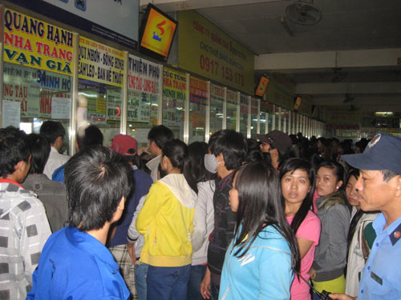
Problem
OVERLOADED!
Customer
Staff
Managing
Scheduling
Selling tickets
Waiting for hours to buy tickets

Slide 5



Solution
Managing bus
Managing route
Managing fares
Scheduling
Booking tickets
Online payments
Long Travel Bus Reservation
Consult transaction history

Slide 6
Terms
Route and segments
Hà Nội
Hồ Chí Minh City
Đà Nẵng
Hải Phòng
Route: Hồ Chí Minh City – Hải Phòng contains 2 segments:
Hồ Chí Minh City – Đà Nẵng,
Đà Nẵng – Hải Phòng
Route: Hồ Chí Minh City – Hà Nội contains 2 segments:
Hồ Chí Minh City – Đà Nẵng,
Đà Nẵng – Hà Nội

Slide 7
Terms
Tariff
Hồ Chí Minh City
Đà Nẵng
200,000 VND
Hải Phòng
Segment | Valid time | Fare
Hồ Chí Minh City – Đà Nẵng | 30/04/2013 | 200,000 VNĐ
Hồ Chí Minh City – Đà Nẵng | 01/06/2013 | 250,000 VNĐ
From 30/04/2013 – 31/05/2013: 200,000 VNĐ
From 01/06/2013 – future: 250,000 VNĐ

Slide 8

Terms
Schedule and trip
Hồ Chí Minh City
Đà Nẵng
10:30 1/5/2013
03:30 2/5/2013
Hải Phòng
20:30 2/5/2013
Schedule
Bus A is scheduled to run on route Hồ Chí Minh City – Hải Phòng from 10:30 1/5/2013 to 20:30 2/5/2013
Trip
There are 2 trips in the schedule
Hồ Chí Minh City (10:30 1/5/2013) – Đà Nẵng (3:30 2/5/2013)
Đà Nẵng (3:30 2/5/2013) – Hải Phòng (20:30 2/5/2013)

Slide 9

Terms
Ticket and journey
Hồ Chí Minh City
Đà Nẵng
10:30 1/5/2013
03:30 2/5/2013
Hải Phòng
20:30 2/5/2013
Ticket
Customer 1 books for a ticket from Hồ Chí Minh City to Hải Phòng (ticket has 2 trips)
Customer 2 books for a ticket from Đà Nẵng to Hải Phòng (ticket has 1 trip)
Journey
Hồ Chí Minh City – Đà Nẵng – Hải Phòng
Đà Nẵng – Hải Phòng

Slide 10


Main functions
Managing bus
Managing route
Staff
Scheduling

Slide 11
Main Functions
Search for journey
Booking
Scheduling
Vehicles management
Fare
User management

Slide 12
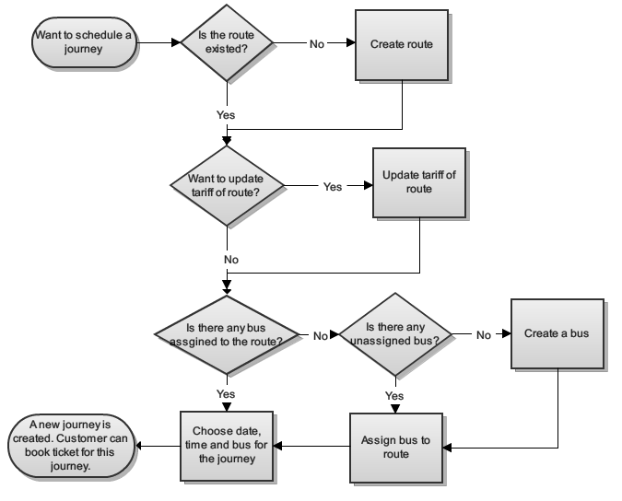
System Flow

Slide 13
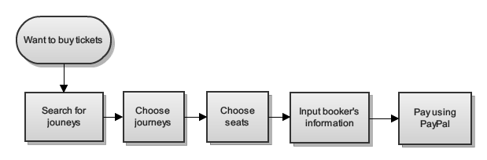
Booking Flow

Slide 14
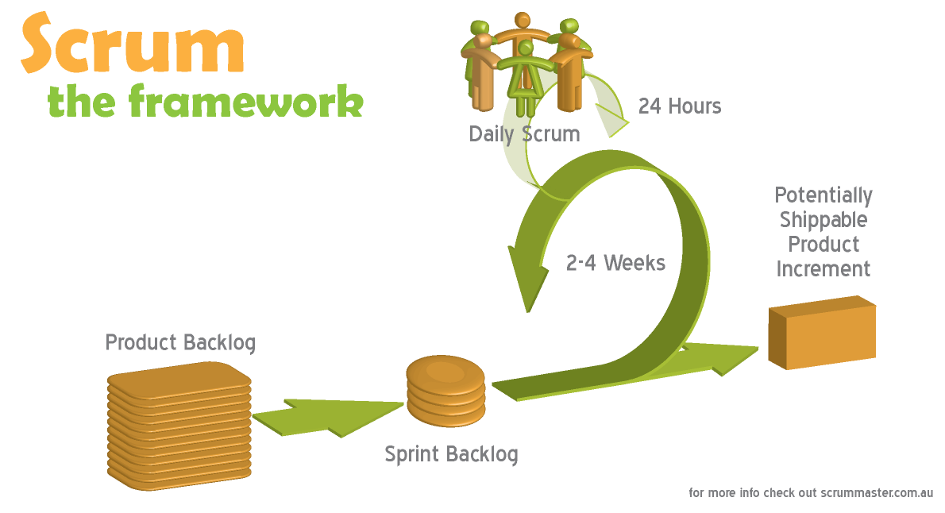
Software Process Model

Slide 15





Tools And Techniques
Tools :
Eclipse Indigo
Tomcat 6.0.26
Mysql Server 5.5
Google Code
Tortoise SVN

Slide 16












Tools And Techniques
Techniques :

Slide 17
Demo

Slide 18
Summary
Advantages
Customer can book for tickets easily and choose the seats they want.
Manage, scheduling for bus.
Payment with PayPal.
Disadvantages
Staff have to schedule for each journey.
Support only one online payment method.
User cannot change tickets or change seats in past reservation

Slide 19
Summary
Future plan
Auto-schedule for each route, bus in a fixed time.
Integrate more online payment methods (Bảo Kim, Ngân Lượng)
Support user to change tickets or seats.
Improve system performance.
Improve system as user friendly as possible.

Slide 20
Thanks for your listening
Q&A

